Slide 1





PRESENTATION 2026
Student Name
Student Email
Barad Vaidehiba Jaydipsinh
jaydipsinhbarad459@gmail.com
& vaidehibabarad459@gmail.com
Mentor Name
Umamaheshwari mam

Slide 2

Outline
Abstract of the Project
Problem Statement
Proposed Solution
System Architecture
Live Demo of the Project
Embedded Video of Project
Conclusion
Future Scope

Slide 3
Abstract
Purpose : To study house price trends in India And affordability , growth drivers.
Tools : Excel , Ai forecasting models,Power bi.
Outcomes : Dashboards , affordability indices , predictive insights.
Highlight : Unique integration of affordability + predictive analysis.

Slide 4

Problem Statement
Rising house price – affordability challenges for middle-income buyers.
Lack of integrated dashboards combining affordability , growth trends , and predictive analysis .
Target users : policymakers , investors , buyers.
Scope : focus on urban cities ( Delhi-NCR , Bengaluru , Hyderabad , Pune , Mumbai) .

Slide 5

Proposed Solution
Build a Data-Driven dashboard.
Integrate house price dataset, affordability indices, and AI – based predictive models.
benefits : clear city-wise insights , affordability gap analysis , future forecasts.
Innovation : Combines multiple Tools ( Excel , Python, AI)

Slide 6
System Architecture
Data Input / Source
Processing / Analysis
House price dataset containing features like bedrooms, bathrooms, area, and price.
Data cleaning and analysis is done using Excel, including pivot tables and charts.
AI / Tool Integration
Output / Dashboard
AI chatbot is created using Microsoft Copilot Studio to answer user queries.
Power bi dashboard and chatbot responses showing insights and answers.

Slide 7
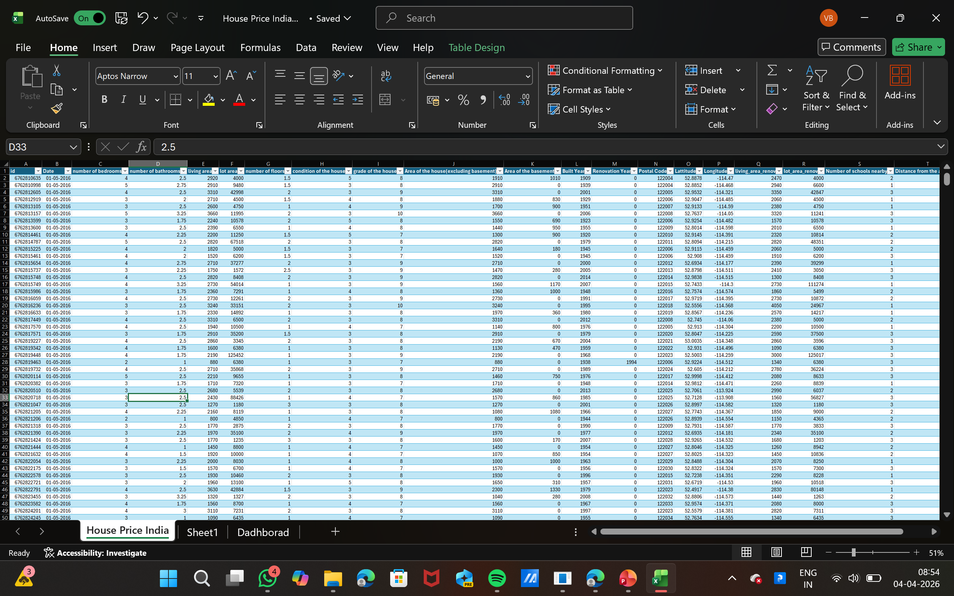
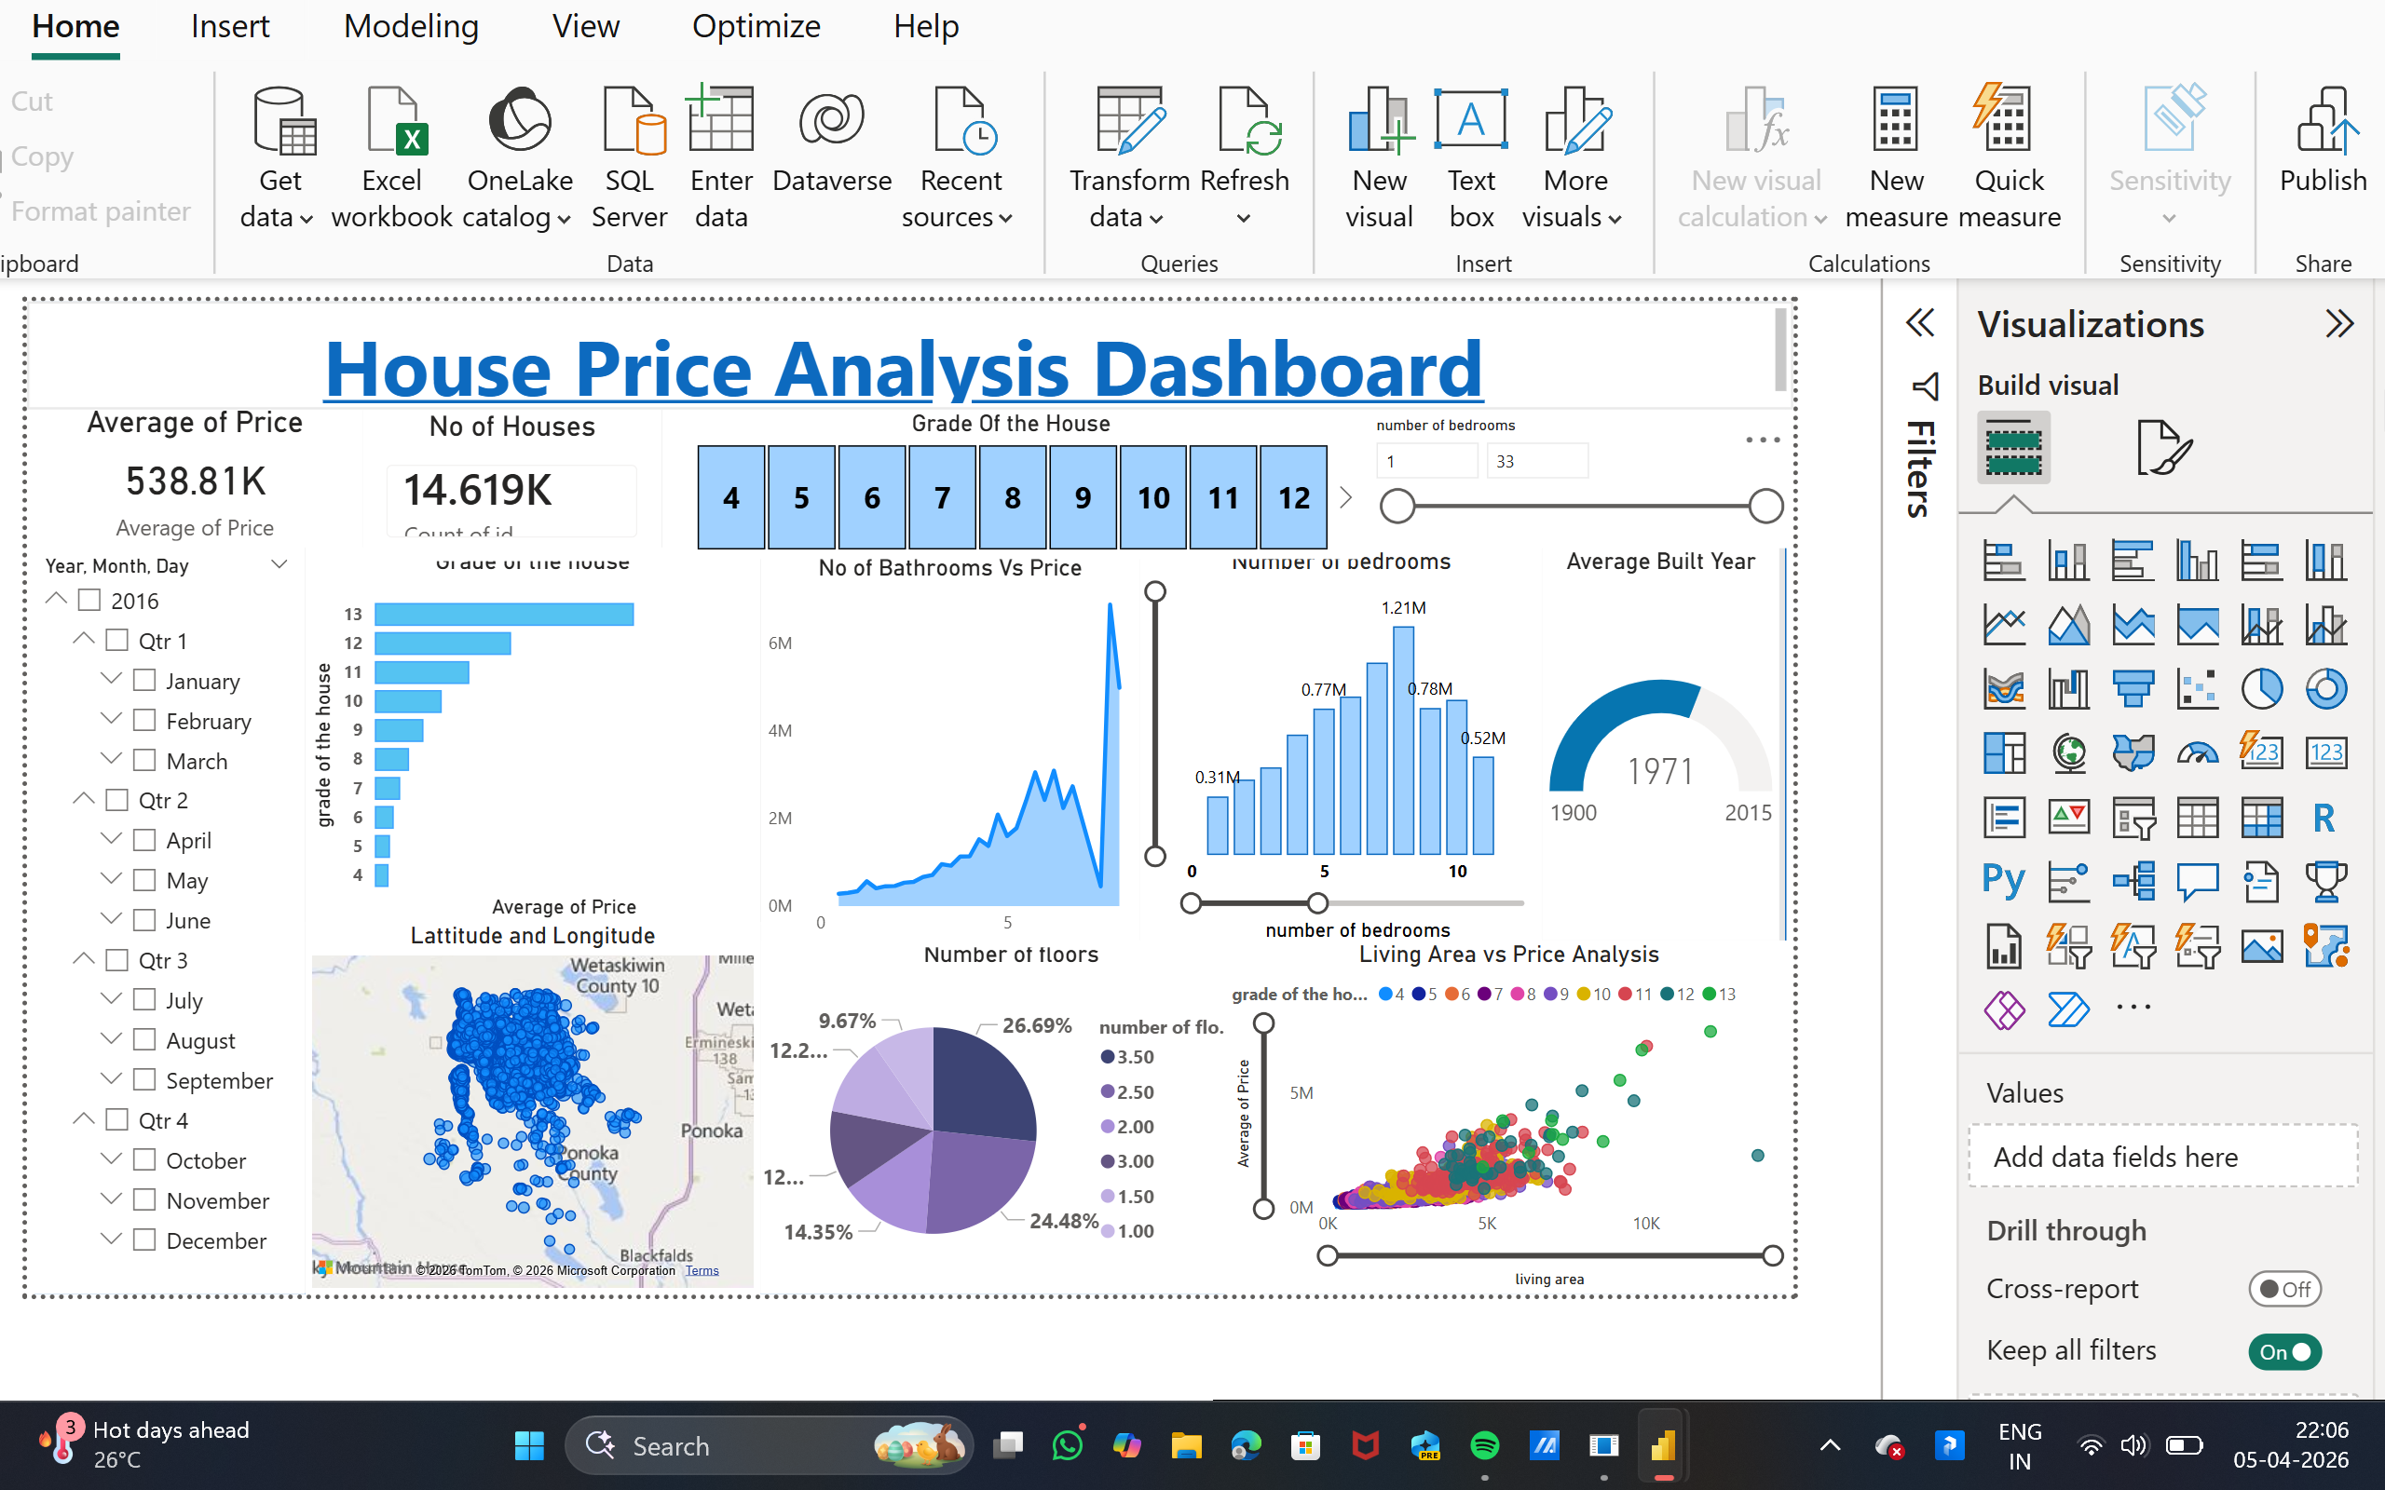
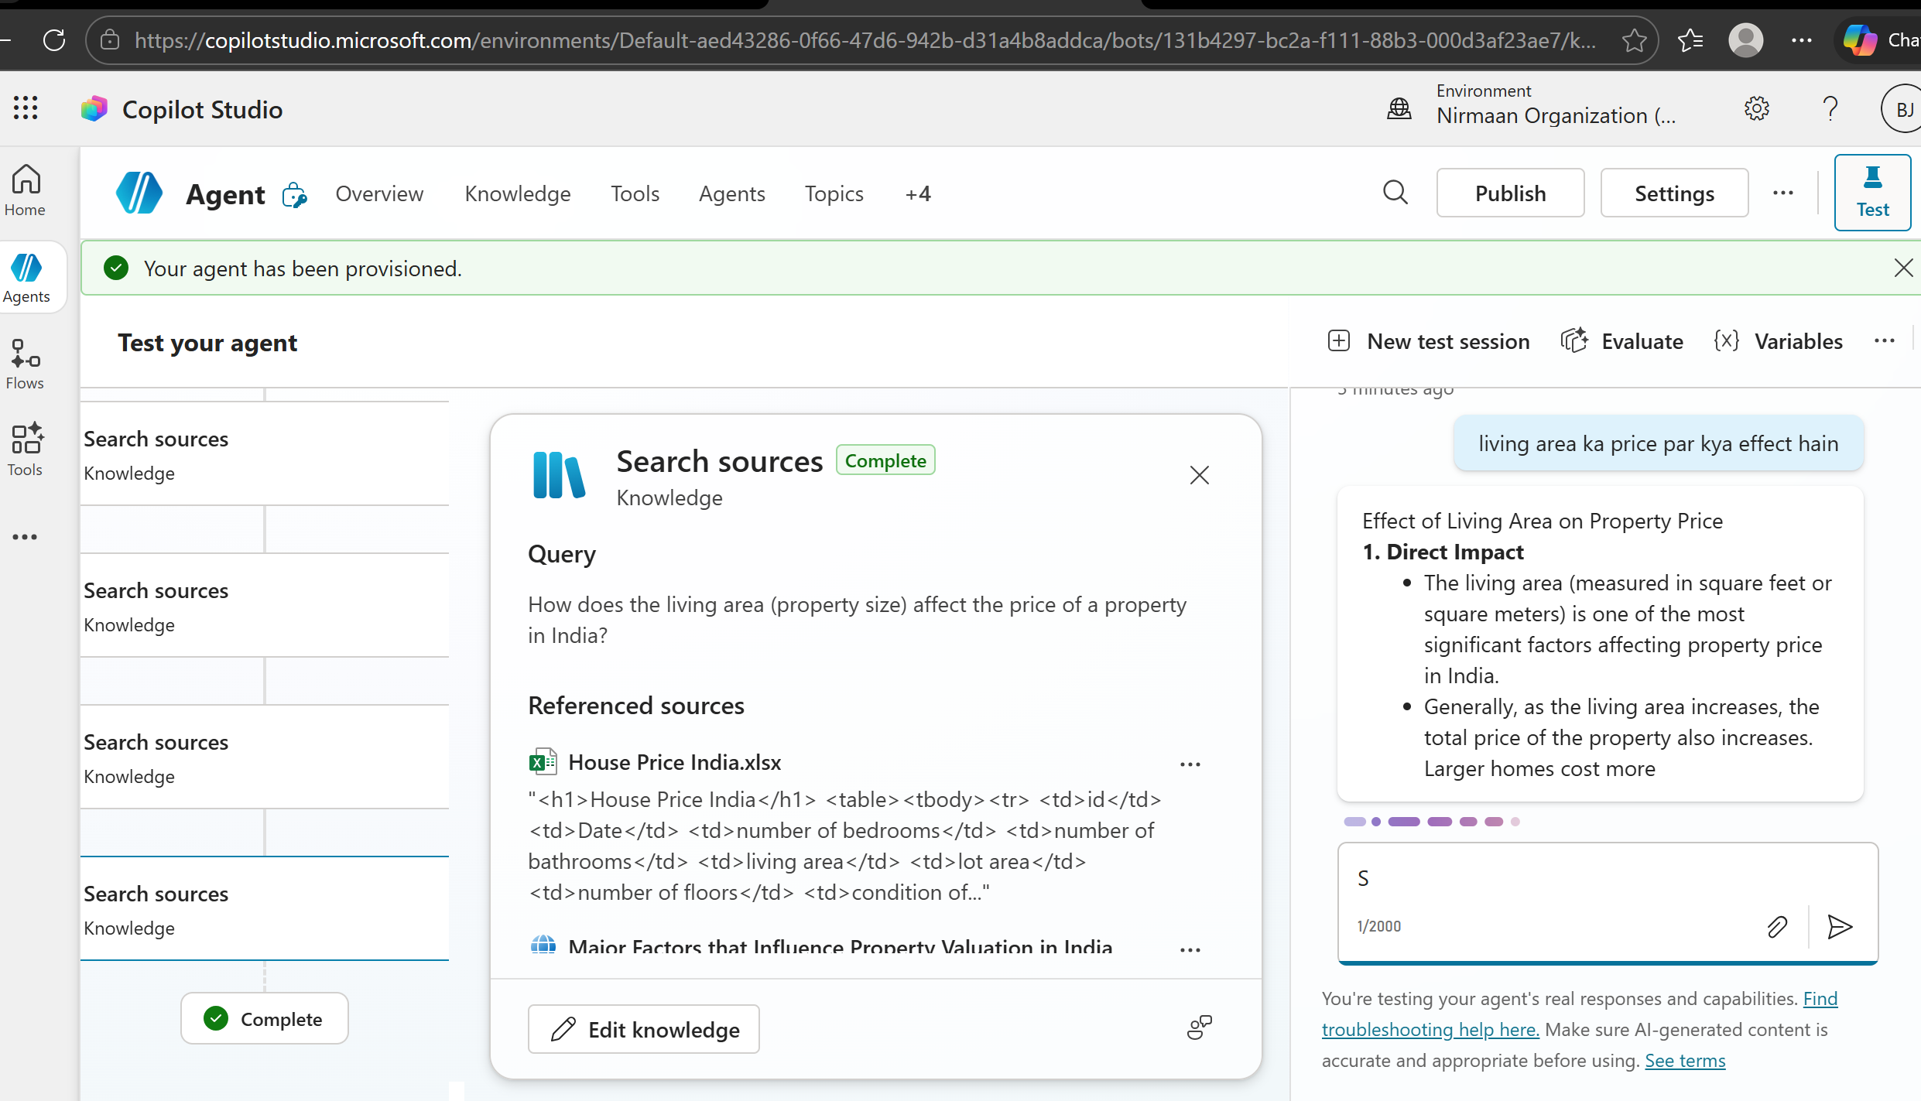
Live Demo of Project
Here's the list of some demo screenshots / features of the project:
Demo 1
Dataset
Demo 2
Price Trends dashboard
Demo 3
Predictive Analysis
Cleaned data(Removing missing values & errors)and prepared data for dashboard analysis.
Analysis of year house price trends across cities in India, highlight growth patterns and market changes.
.
Ai Chatbot Response to the answer to the Question and Activated and correct & Accurate answer provide.

Slide 8
Video of Project Demo
https://1drv.ms/v/c/81CC0BDDD2E609BB/IQDqYJyTuU8_S49A86mGlavBAZGQC_xs7ggm1zXDBfMW8Tg?e=80s0DO
▶
This dashboard Present a comprehensive analysis of House prices in India using data visualization techniques.it includes key insights such as price variation based on number of bedrooms ,house grade ,and living area. The dashboard also shows trends based on built year ,distance from airport ,and floor distribution. Interactive filters like date selection help in better understanding and analysis of real estate data.

Slide 9

Conclusion
The Project successfully integrates multiple tools to provide actionable insights into house price trends in India.
Objectives of affordability analysis and predictive modeling were achieved . This adds value to policymakers , investors , and buyers. Adds value by combining multiple tools into one integrated solution.
CONCLUSION

Slide 10

Future Scope
Expand datasets to include rental markets.
Integrate real – time APIs for dynamic updates.
Enhance predictive models with machine learning.
Scale dashboards for broader geographic coverage.

Slide 11
Thank You
AICW Fellowship | Student Project Presentation 2026
LinkedIn | Edunet Foundation

